Slide 1
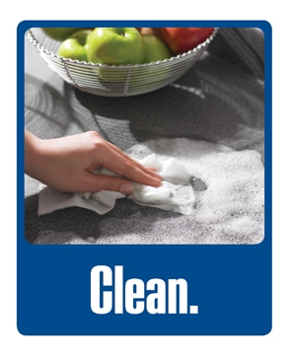
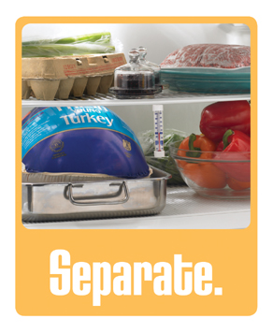
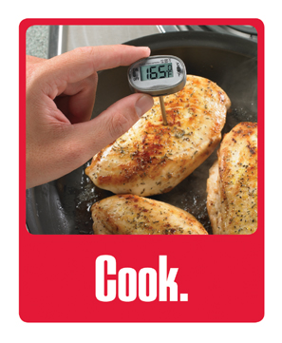
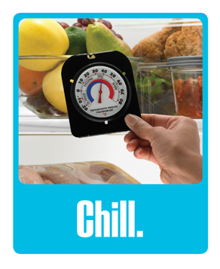
Steps To Preventing A Foodborne Illness

Slide 2
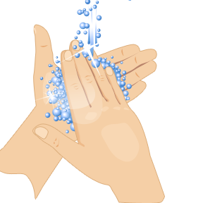
Step 1: Clean
Wash the following in hot soapy water before, during and after each time you cook.
  Cutting boards
  Utensils
  Knives
  Countertops
Wash hands often during food preparation.
Wash your fruits and vegetables before you eat or cook them.

Slide 3
Step 2: Seperate
Separate ready to eat food from raw food.
  Store cooked foods and raw foods in different areas of the refrigerator.
Use different cutting boards.
  One for fruits and vegetables.
  One for raw meats, poultry, and seafood.
Put cooked food on a clean plate.

Slide 4
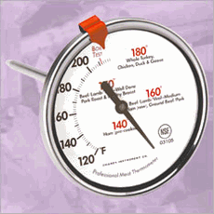
Step 3: Cook
Use a food thermometer to measure the internal temperature of the food.
  Ensures your food is cooked to a safe temperature.
  Safe temperatures can be found at http://www.foodsafety.gov/keep/charts/mintemp.html

Slide 5
Step 4: Chill
Refrigerate or freeze foods within one hour.
Use an appliance thermometer in your refrigerator and freezer.
  Refrigerator – 40 degrees F or below.
  Freezer – 0 degrees F or below.
Thaw food correctly.
  Overnight in the refrigerator.
  Under cold running water.

Slide 6
Always Keep Your Hot Foods Hot And Your Cold Foods Cold!

Slide 7
Conclusion
Clean before, during, and after cooking.
Separate raw food from cooked food.
Cook all food to a safe internal temperature.
Chill all food in the refrigerator and freezer.
Thaw frozen foods correctly.

